Slide 1
LOAN MANAGEMENT SYSTEM
VIJAYALAKSHMI P

Slide 2
SQL (Structured Query Language)
SQL (Structured Query Language)
This is the standardized programming language used for managing and manipulating data held in relational database management systems (RDBMS).
databases that organize data into tables with rows and columns, and they use SQL to interact with that data.

Slide 3
SQL (Structured Query Language)
SQL SERVERS
Microsoft SQL Server
MySQL
PostgreSQL
Oracle Database
SQLite

Slide 4
SQL (Structured Query Language)
SQL STATEMENTS
DDL (Data Definition Language)
DML (Data Manipulation Language)
DQL (Data Query Language)
DCL (Data Control Language)
TCL (Transaction Control Language)

Slide 5
SQL Statements
DDL (Data Definition Language)
Database Creation
Alter Table
Truncate
DML (Data Definition Language)
Inserting values
Updating values
Delete values

Slide 6
SQL Statements
DQL (Data Query Language)
Select queries
General Functions
Aggregate Functions
String Functions
Number Functions
Logical Functions
Joins

Slide 7
SQL Statements
DCL (Data Control Language)
Grant
Revoke
TCL (Transaction Control Language)
Commit
Rollback

Slide 8
Data types
Numeric Data type - (int, tinyint,smallint,bigint,float,double)
Date Time - (date,time,timestamp,datetime,time,year)
String type - (varchar,textsize,text,mediumtext,longtext,binary)
Picture saving - (blob,tinyblob,mediumblob)

Slide 9
SQL queries
To create a Database
create Database table_name;
To create a Table
create table table_name (id,name,age,gender);
To Alter the Table
alter table table_name add column_name datatype;
To truncate the Table
truncate table_name;

Slide 10
SQL Queries
To Drop a Table
drop table table_name;
To Insert a Values into the Table
insert into table name values (23,john,male,20);
To Update the Values
update table_name set column_name = “values” where column_name =
“values”;
To Delete the Table
delete from table_name where column_name = “values”;

Slide 11
LOAN MANAGEMENT SYSTEM
Abstract
This project outlines the development of a Loan Management System leveraging SQL, The system utilizes five interconnected tables: Customer Info, Loan Status, Customer Details, Country State, and Region Info, enabling a holistic view of loan management. Customer segmentation is achieved through loan grades, allowing for differentiated interest rates and risk assessments. Additionally, customers are categorized as rural or urban, facilitating region-specific loan policies. The system incorporates CIBIL score calculation, providing an accurate measure of borrower creditworthiness. Monthly and annual interest calculations are dynamically generated based on loan parameters and customer grades. The implementation utilizes stored procedures to encapsulate complex business logic, enabling efficient data retrieval and report generation. These procedures automate tasks such as loan approval, interest calculation, customer segmentation, and CIBIL score retrieval, delivering a streamlined, secure, and scalable solution for financial institutions, thereby enhancing operational efficiency and minimizing manual errors.

Slide 12
Tables Imported
After creating a database, We have to import the tables for development of Loan Management System
Customer_Info
Loan_status
Customer_det
Country_state
Region_info

Slide 13
Tables Imported
Tables we Created to display the final output
Customer_Criteria
loan_cibil_score_status_details
customer_interest_analysis
Output_1
Output_2
Output_3
Output_4

Slide 14
Triggers and Procedures
Triggers We created and Timings
Loan_amt
Cibil
Procedures we created
Projectoutput()

Slide 15
Queries
1. Customer_info table
Import customer_info table to find a customer income status
set customer criteria based on applicant income
Criteria
Applicant income >15,000 = grade a
Applicant income >9,000 = grade b
Applicant income >5000 = middle class customer
Otherwise low class

Slide 16
Queries
create table customers_criteria as select*,
case
when applicantincome > 15000 then "GRADE A"
when applicantincome > 9000 then "GRADE B"
when applicantincome > 5000 then "Middle class customer“
else "Low class"
end as Criteria from customer_info;

Slide 17
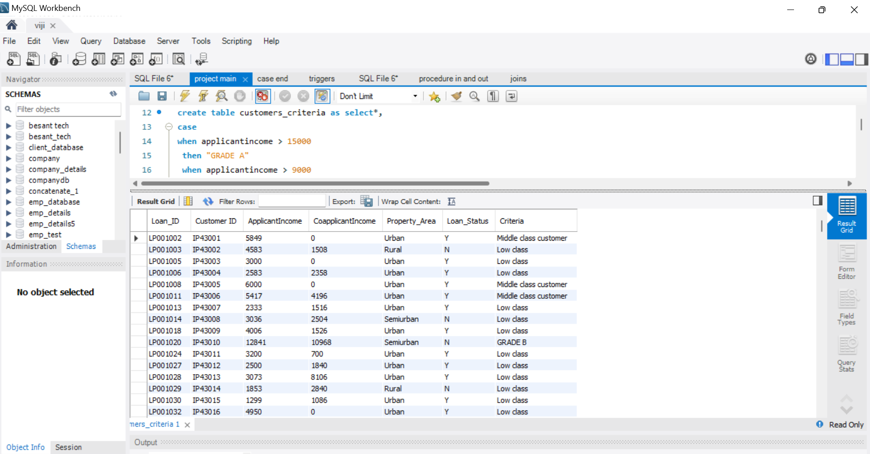
Output

Slide 18
Queries
2. Loan_status
Create row level trigger for loan amt
Create statement level trigger for cibil score
Criteria
Loan amt null = loan still processing
Cibil score >900 high cibil score
Cibil score >750 no penalty
Cibil score >0 penalty customers
Cibil score <=0 reject customers (loan cannot apply)

Slide 19
Queries
Criteria
Then delete the reject and loan still processing customers
Update loan as integers
delete from cibil_score where cibil_score_status = "reject customers"; delete from cibil_score where loan_amount = "Loan still processing";
alter table cibil_score modify loan_amount integer;

Slide 20
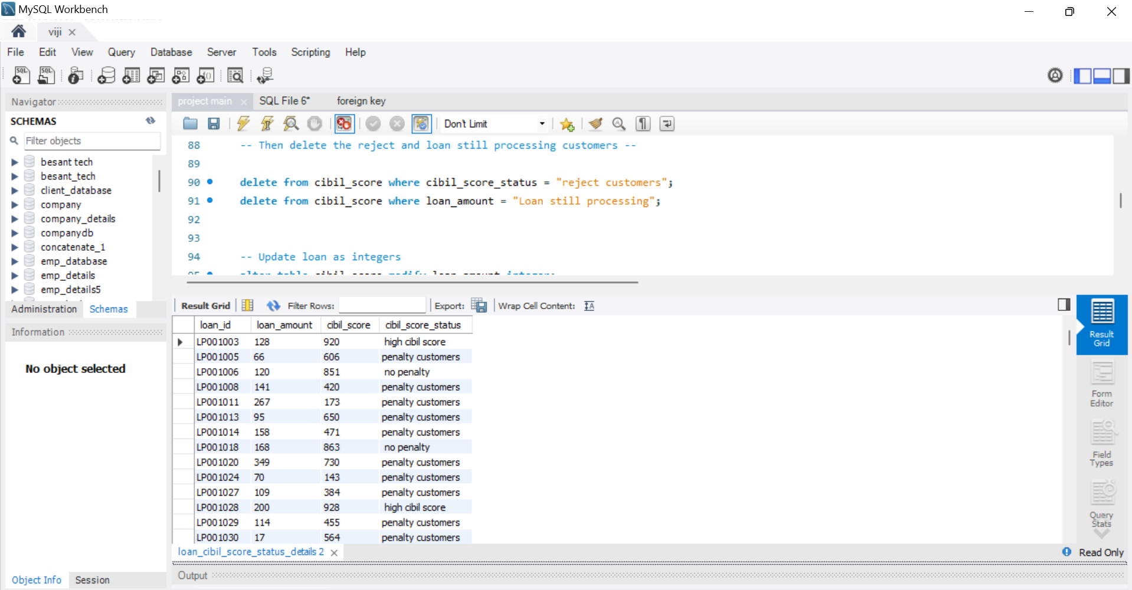
Output

Slide 21
Queries
create before insert trigger
create table dummy (loan_id text, customer_id text, loanamount text, loan_amount_term int, cibil_score int);
delimiter //
create trigger loan_amt before insert on dummy for each row
begin if new.loanamount is null then set new.loanamount = "Loan still processing";
end if;
end
// delimiter ;

Slide 22
Queries
Create after insert trigger
Primary table
create table dummy (loan_id text, customer_id text, loanamount text, loan_amount_term int, cibil_score int);
Secondary table
create table cibil_score (loan_id text, loan_amount text, cibil_score int, cibil_score_status varchar(30));

Slide 23
Queries
delimiter //
create trigger cibil after insert on dummy for each row
Begin
insert into cibil_score (loan_id, loan_amount, cibil_score, cibil_score_status) values (new.loan_id, new.loanamount, new.cibil_score,
case
when new.cibil_score >900 then " high cibil score“
when new.cibil_score >750 then " no penalty“
when new.cibil_score >0 then "penalty customers“
when new.cibil_score <=0 then "reject customers“
end );
end
// delimiter ;

Slide 24
Queries
Monthly interest percentage
Criteria
Applicant income <5000 rural=3%
Applicant income <5000 semi rural=3.5%
Applicant income <5000 urban=5%
Applicant income <5000 semi urban= 2.5%
Otherwise =7%

Slide 25
Queries
create table monthly_interest as select *,
case
when applicantincome < 5000 and property_area = "rural" then "3%“
when applicantincome < 5000 and property_area = "semirural"then "3.5%“
when applicantincome < 5000 and property_area = "urban"then "5%“
when applicantincome < 5000 and property_area = "semiurban"then "2.5%“
else "7%“
end as Monthly_interest_percentage from customer_info;

Slide 26
Queries
New field creation based on interest
Calculate monthly interest amt and annual interest amt based on loan amt
Create all the above fields as a table
Table name - customer interest analysis
create this into a new table and connect with (loan status) bring the output

Slide 27
Queries
Monthly interest and annual interest calculation
create table customer_interest_analysis select m.*,
l.loan_amount, l.cibil_score,l.cibil_score_status,
case
when applicantincome < 5000 and property_area = "rural" then (loan_amount * 3 /100)
when applicantincome < 5000 and property_area = "semirural"then (loan_amount * 3.5 / 100)
when applicantincome < 5000 and property_area = "urban"then (loan_amount * 5 /100)
when applicantincome < 5000 and property_area = "semiurban"then (loan_amount * 2.5 /100)
else (loan_amount * 7 /100)
end as Monthly_interest,

Slide 28
Queries
case
when applicantincome < 5000 and property_area = "rural" then (loan_amount * 3 /100) * 12
when applicantincome < 5000 and property_area = "semirural"then (loan_amount * 3.5 / 100) * 12
when applicantincome < 5000 and property_area = "urban"then (loan_amount * 5 /100) * 12
when applicantincome < 5000 and property_area = "semiurban"then (loan_amount * 2.5 /100) * 12
else (loan_amount * 7 /100) * 12
end as Annual_interest from monthly_interest m inner join loan_cibil_score_status_details l on m.loan_id = l.loan_id;

Slide 29
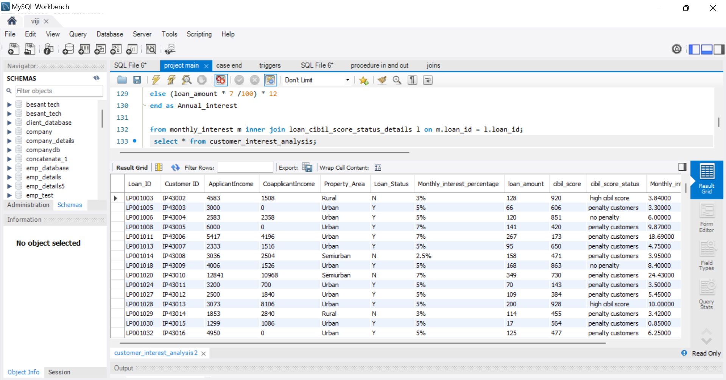
Output

Slide 30
Queries
3. Customer details
Import the table
Update gender and age based on customer id
4. Country state and region
Import the table

Slide 31
Queries
update customer_det set gender = "Female" where customerid ="IP43006";
update customer_det set gender = "Female" where customerid ="IP43016";
update customer_det set gender = "Male" where customerid ="IP43018";
update customer_det set gender = "Male" where customerid ="IP43038";
update customer_det set gender = "Female" where customerid ="IP43508";
update customer_det set gender = "Female" where customerid ="IP43577";
update customer_det set gender = "Female" where customerid ="IP43589";
update customer_det set gender = "Female" where customerid ="IP43593";
update customer_det set age = 45 where customerid ="IP43007";
update customer_det set age = 32 where customerid ="IP43009";

Slide 32
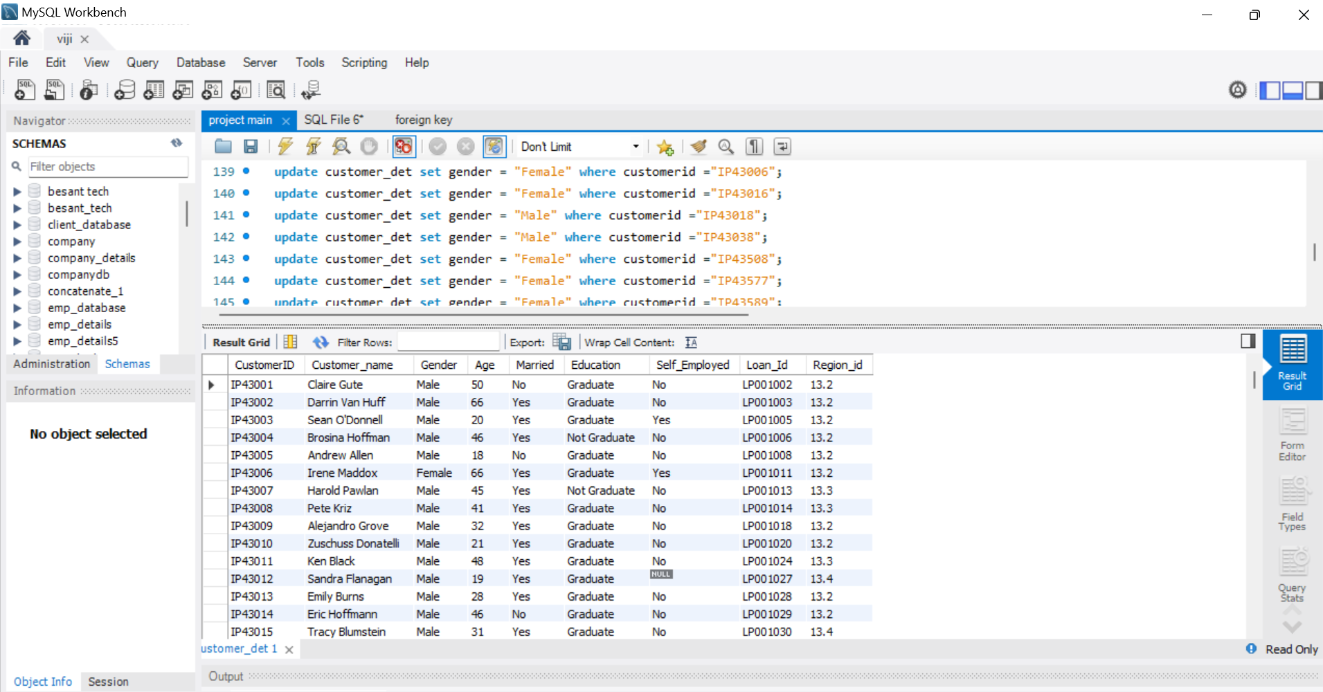
Output

Slide 33
Queries
Final output conditions
Join all the 5 tables without repeating the fields - output 1
find the mismatch details using joins - output 2
Filter high cibil score - output 3
Filter home office and corporate - output 4
Store all the outputs as procedure

Slide 34
Queries
output 1
create table output_1 as select a.*,
c.loan_amount,c.cibil_score,c.cibil_score_status,c.monthly_interest,c.annual_interest,
d.customerid,d.customer_name,d.gender,d.age,d.married,d.education,d.self_employed,
d.region_id,r.postal_code,
r.segment,r.statefrom customers_criteria a
inner join customer_interest_analysis c on a.loan_id = c.loan_id
inner join customer_det d on c.loan_id = d.loan_id
inner join country_state r on d.customerid = r.customerid;

Slide 35
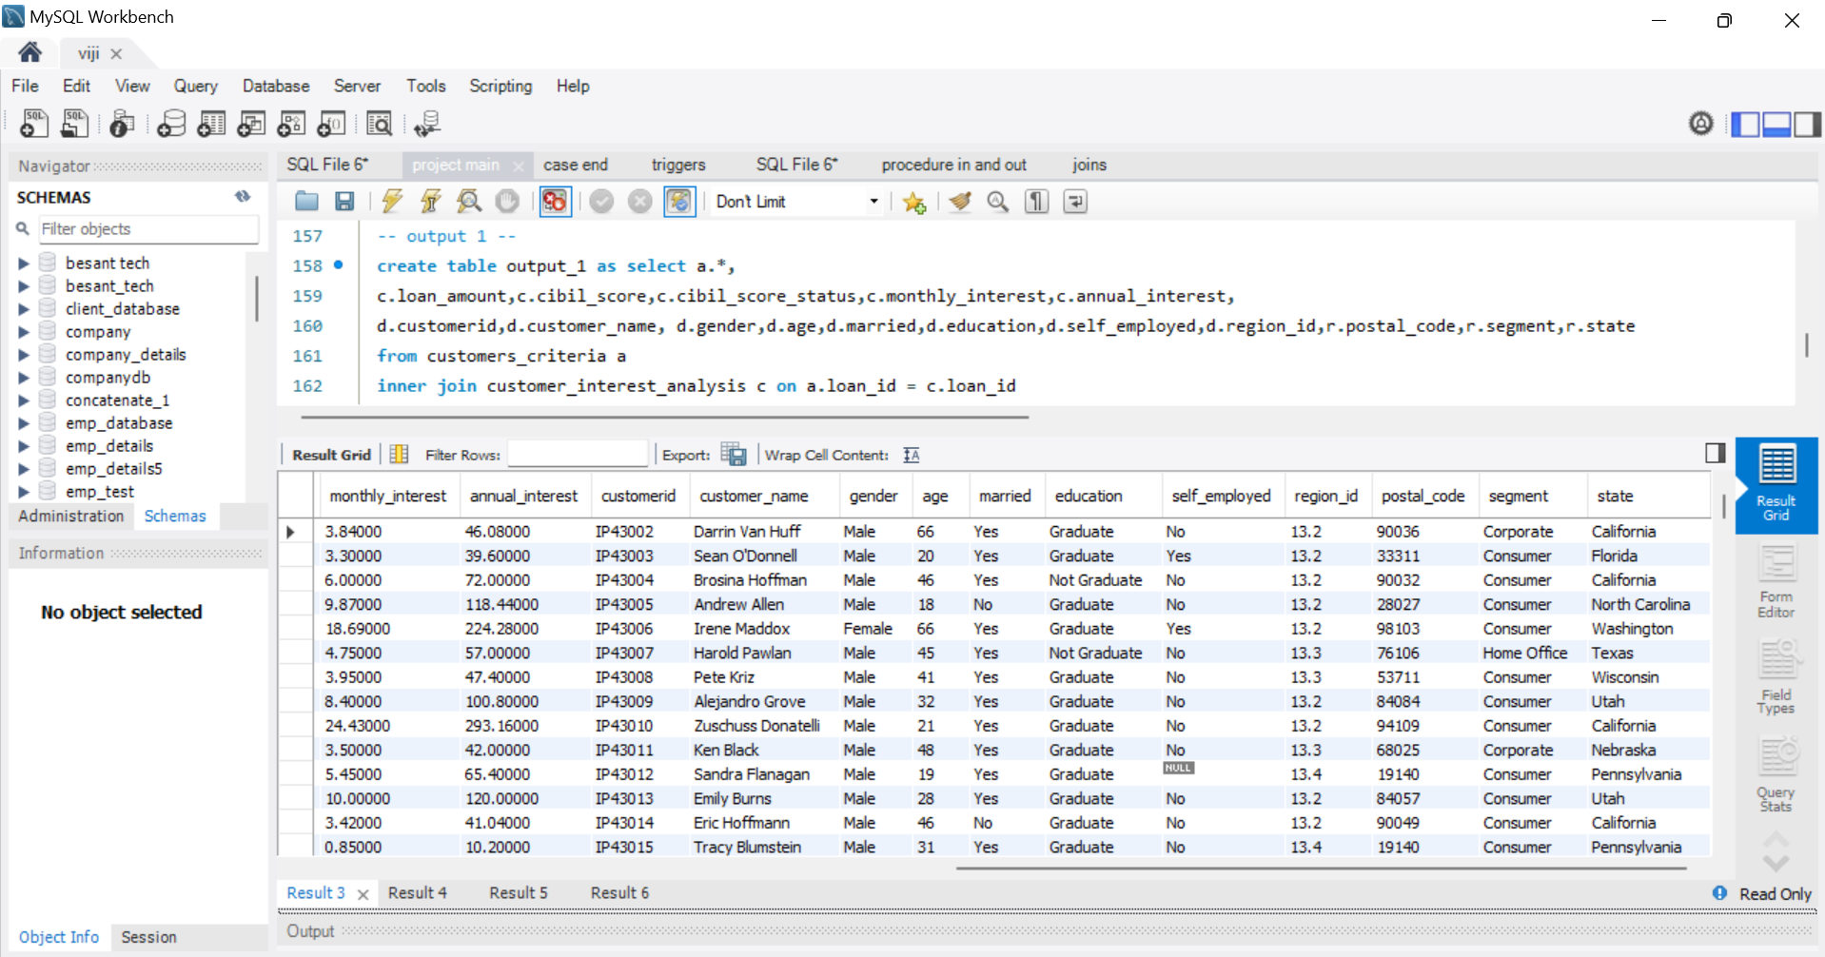
Output

Slide 36
Queries
output 2
create table output_2 as select c.*,
s.postal_code,s.segment,s.state,r.region from customer_det c
right join country_state s on c.customerid = s.customerid
right join region_info r on r.region_id = s.region_id
where c.customerid is null and s.segment is null ;

Slide 37
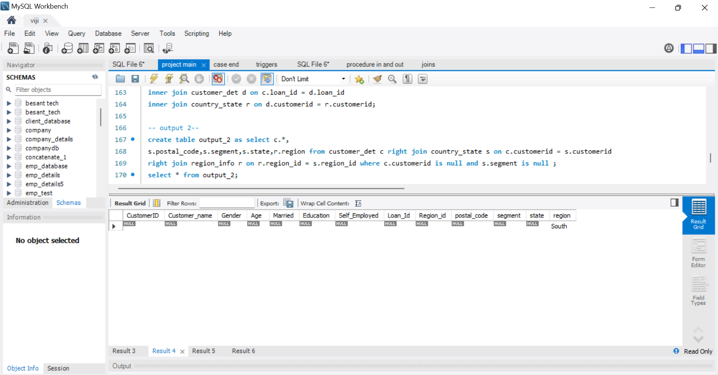
Output

Slide 38
Queries
Output 3
create table output_3 as select
a.*,c.loan_amount,c.cibil_score,c.cibil_score_status,c.monthly_interest,c.annual_interest,
d.customerid,d.customer_name,d.gender,d.age,d.married,
d.education,d.self_employed,d.region_id,
r.postal_code,r.segment,r.statefrom customers_criteria a
inner join customer_interest_analysis c on a.loan_id = c.loan_id
inner join customer_det d on c.loan_id = d.loan_id
inner join country_state r on d.customerid = r.customerid
where c.cibil_score_status = ' high cibil score';

Slide 39
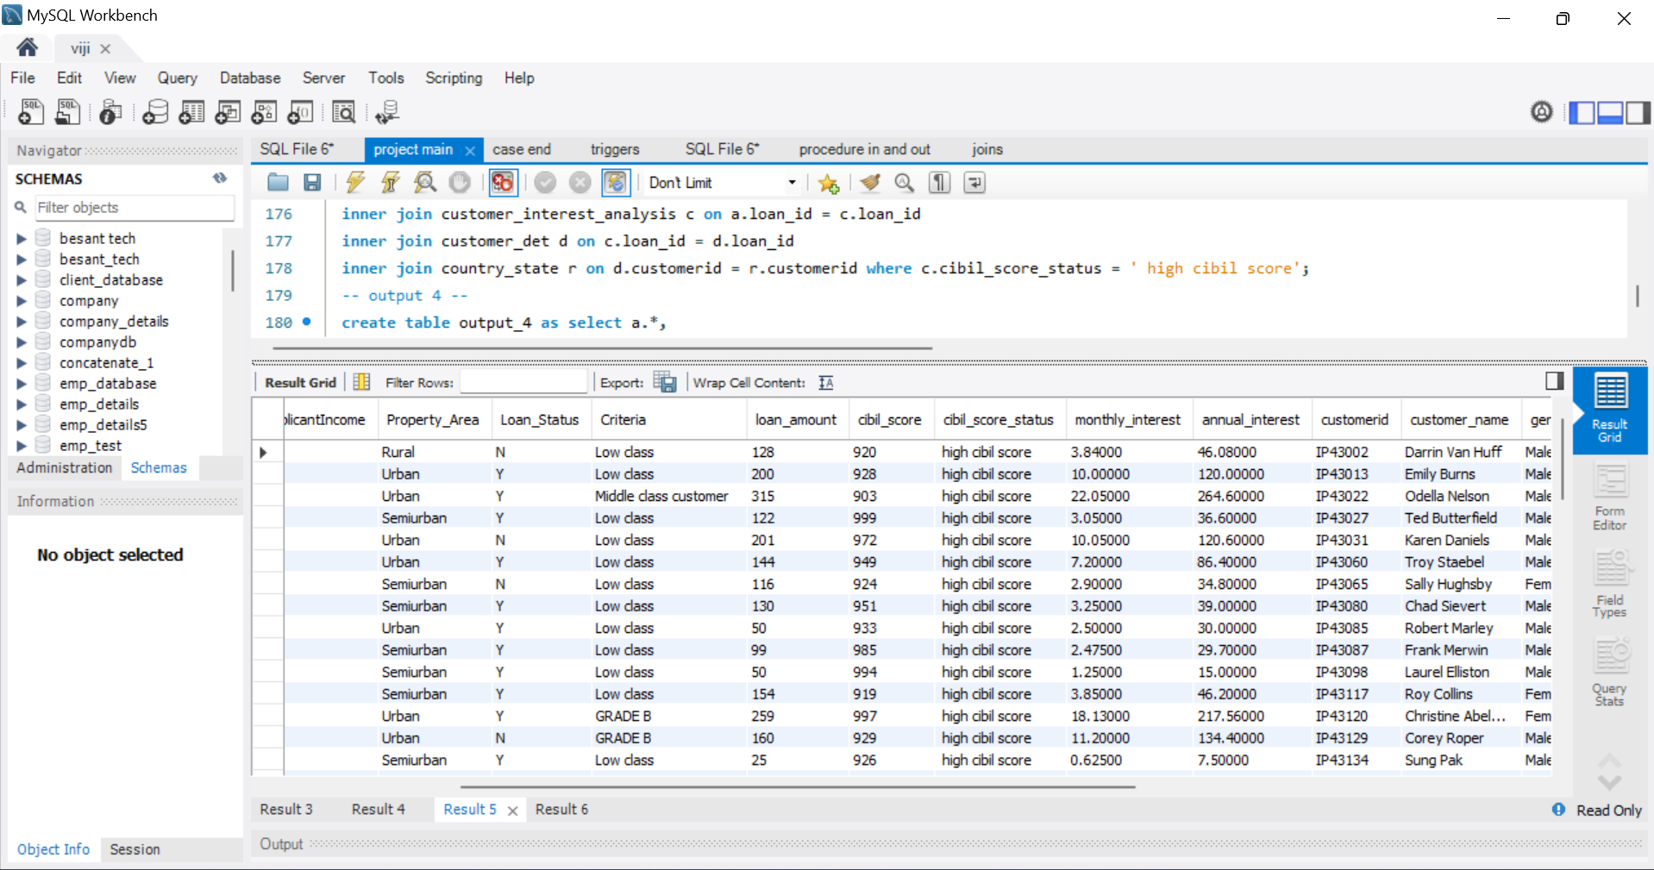
Output

Slide 40
Queries
Output 4
create table output_4 as select a.*,c.loan_amount,c.cibil_score,c.cibil_score_status,c.monthly_interest,c.annual_interest,
d.customerid,d.customer_name,d.gender,d.age,d.married,d.education,d.self_employed,
d.region_id,r.postal_code,r.segment,r.statefrom customers_criteria a
inner join customer_interest_analysis c on a.loan_id = c.loan_id
inner join customer_det d on c.loan_id = d.loan_id
inner join country_state r on d.customerid = r.customerid
where segment in ('home office', 'corporate');

Slide 41
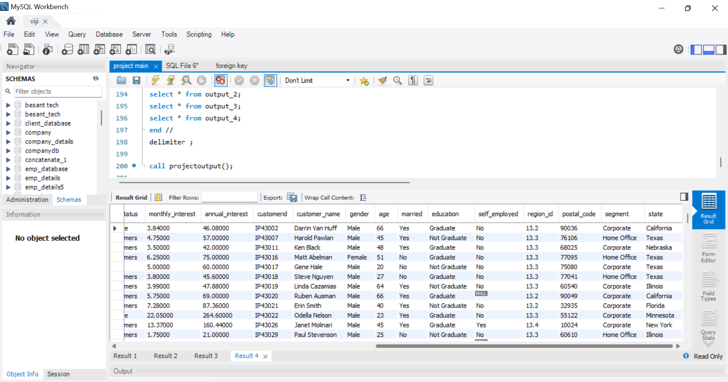
Output

Slide 42
Queries
storing in procedure
delimiter //
create procedure projectoutput ()
Begin
select * from output_1;
select * from output_2;
select * from output_3;
select * from output_4;
end //
delimiter ;
call projectoutput();

Slide 43
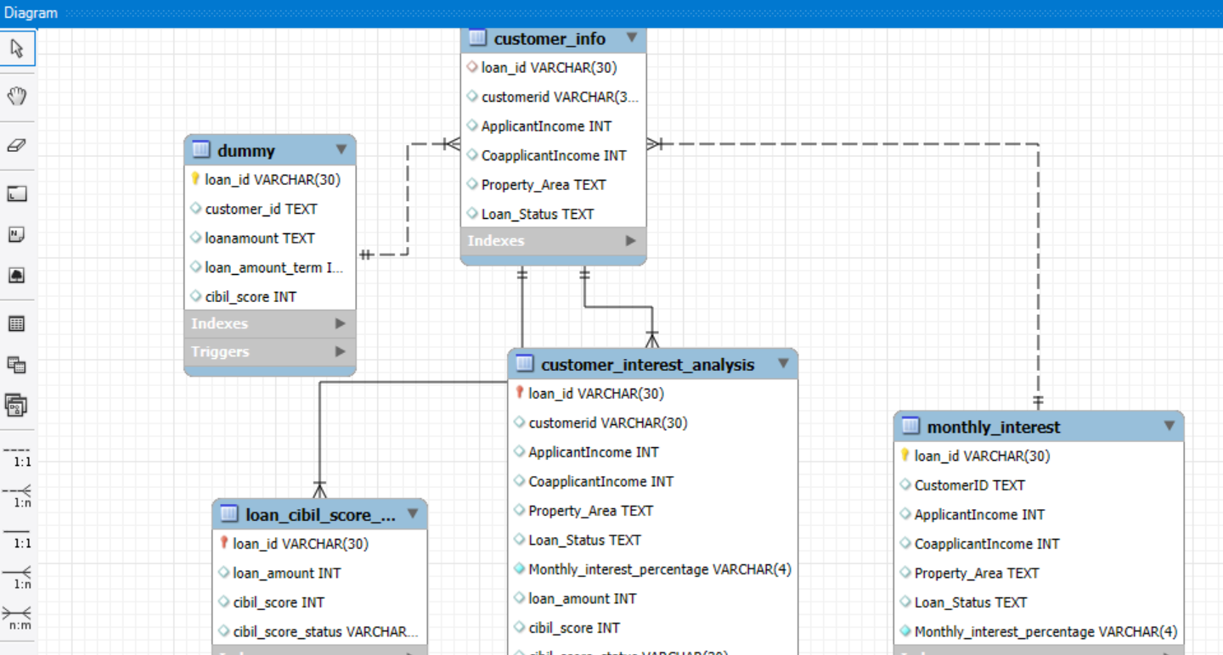
Output

Slide 44
Thank You

